Slide 1
MOOD BASED MUSIC RECOMMENDATION SYSTEM
MET-A-FOUR
Chiru Anand Vaka
Venkata Roshan Reddy Rajala
Saikumar Atchi
Heet Patel
Prepared For:
Dr. Hubert A. Johnson CSIT 515-02 Software Engineering & Reliability

Slide 2
CONTENTS:
INTRODUCTION
EXISTING SYSTEM
PROPOSED SYSTEM
ADVANTAGES OF PROPOSED SYSTEM
CNN ARCHITECTURE
METHODOLOGY
DATAFLOW DIAGRAM
HARDWARE & SOFTWARE REQUIREMENTS
RESULTS
CONCLUSION

Slide 3
INTRODUCTION
Music is an important entertainment medium for with advancement of technology, the optimization of manual work has gained a lot of attention.
Currently, there are many traditional music players that require songs to be manually selected and organized.
User, have to create and update play list for each mood, which is time consuming.
Although some of these features are enjoyable for user, there is room to improve in the field of automation when it comes to music players.
Selecting songs automatically and organizing these based on the user’s mood gives user’s a better experience.

Slide 4
EXISTING SYSTEM
There are many existing music player applications. Some of the interesting applications among them are:
Apple Music
YouTube Music
Spotify
These application gives good user accessibility features to play songs and recommends us with other songs of similar genre.
Limitations of existing system:
It requires the user to manually select the songs.
Randomly played songs may not match the mood of the user.

Slide 5
PROPOSED SYSTEM
We consider the notion of collecting human emotion from the user’s expressions, and explore how this information could be used to improve the user’s experience with audio players.
We present a new emotion based and user interactive music system
Proposed System aims to provide user preferred music based on emotion by recognizing face expressions. Based on user emotions, songs related to that emotion will be played.

Slide 6
ADVANTAGES OF PROPOSED SYSTEM
Ease Of Use.
Plays Songs as per users mood.
No trouble selecting the songs manually.
Free of cost.

Slide 7
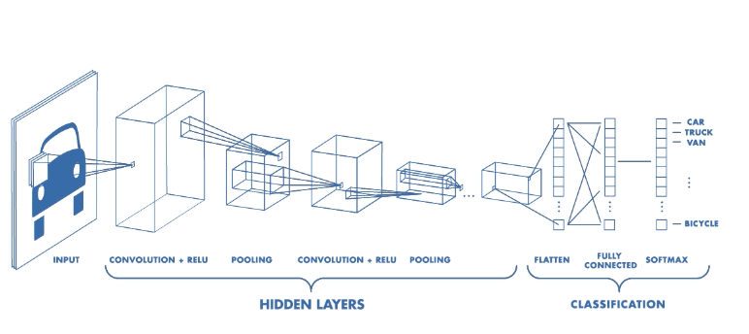
CNN Architecture

Slide 8
A Convolutional Neural Network, also known as CNN or ConvNet,lerns multi-leval features and classifier in a joint fashion and performs much better than traditional approaches for various image classification and segmentation problems.
There are four main components in the CNN:
1.convolution
2.Non-linearity
3.Pooling
4.classification(Fully connected layer)
Input:An image is a matrix of pixel values.
If we consider agray scale image,the values of each pixel in the matrix will range from 0 to 255

Slide 9
METHODOLOGY
The mood-based music recommendation system is an application that focuses on implementing real time mood detection.
It is a prototype of a new product that comprises two main modules: Facial expression recognition/mood detection and Music recommendation.
Mood Detection Module: This Module is divided into two parts:
Face Detection
Mood Detection
Music Recommendation Module:

Slide 10
1.Mood Detection Module:
Face Detection —Ability to detect the location of face in any input image or frame.
The output is the bounding box coordinates of the detected faces.
For this task, the python library OpenCV was considered and Haar Cascade Classifier.
Haar Cascade is an Object Detection Algorithm used to identify faces in an image or a real time video.
The algorithm is given a lot of positive images consisting of faces, and a lot of negative images not consisting of any face to train on them.
The face model detects the coordinates of a face. We take one coordinate at a time, and get the rectangular data from the gray image(pixels).

Slide 11
Mood Detection — Classification of the emotion on the face as happy, angry, sad, calm,surprise.
For this task, the traditional Keras module of Python was used.
Using the libraries and functions available in Keras we built a model for mood detection

Slide 12
Dataset for Training of Mood detection model:
The dataset used for training was obtained from Kaggle which consists of FER 2013 dataset.
The FER 2013 dataset contains grayscale images of size 48x48 pixels.
It consists of 35887 images out of which nearly 20,000 images are for training and remaining are for validation.
A CNN was used with Keras to train and test our model for seven classes - happy, angry, neutral, sad, surprise, fear and disgust. We trained it for 100 epochs and achieved an accuracy of approximately 83%.

Slide 13
Music Recommendation Module
The dataset of songs classified as per mood was found on Kaggle for language:English
Research for a good cloud storage platform to store, retrieve and query this song data as per user’s request was conducted.
Options like AWS, Google Cloud, etc. were found but these were rejected as they were costly and provided very limited storage for free.

Slide 14
START
Input
Face Detection
Processing input using
Haar Cascade Classifier
Detect New Mood
Recommend Music
Mood Detection
END

Slide 15
HARDWARE & SOFTWARE REQUIREMENTS
Hardware Requirements :
The hardware requirements required for this project are:
Minimum 4 Gigabyte (GB) RAM (used for processing)
Webcam (for testing on laptop/desktop)
Minimum 16 Megapixel (MP) Resolution camera (for testing on android device)
30 MB Memory space (approximate value)
Software Requirements :
They deal with defining software resource requirements and prerequisites that need to be installed on a computer to provide optimal functioning of an application. The software requirements that are required for this project are:
Python 3.6
OpenCV 3.1
Visual Studio
Jupyter/Google Colab

Slide 16
RESULTS :
As every person has unique facial features, it is difficult to detect accurate human emotion or mood.
But with proper facial expressions, it can be detected up to a certain extent.
The camera of the device should have a higher resolution.
The system detects the mood in real time and a playlist is displayed for that mood accurately.

Slide 17
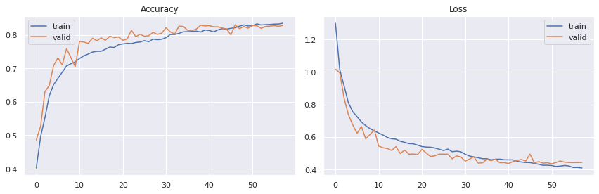
Accuracy:
The graph displays the accuracy of our model, where the x-axis specifies the number of epochs and the y-axis specifies the accuracy.
As it can be seen in the figure, the epoch’s history shows that accuracy gradually increases and achieved +83% accuracy on both training and validation set. Since it is a fully computer-based system, it understands emotions in the way it has been trained. FSF

Slide 18

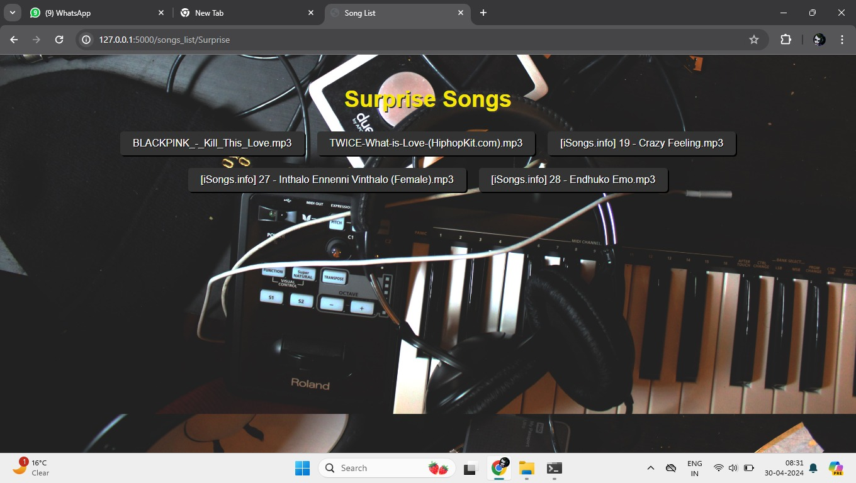
Some of the screenshots while detecting the mood

Slide 19

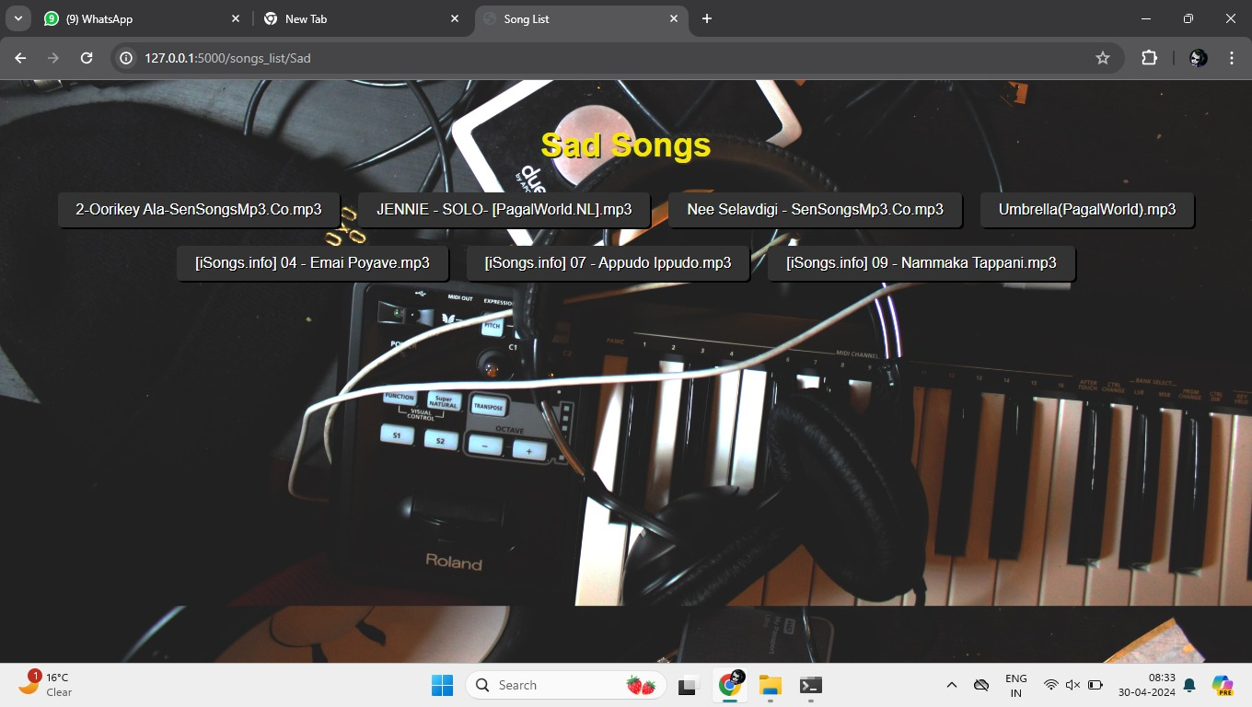

Slide 20
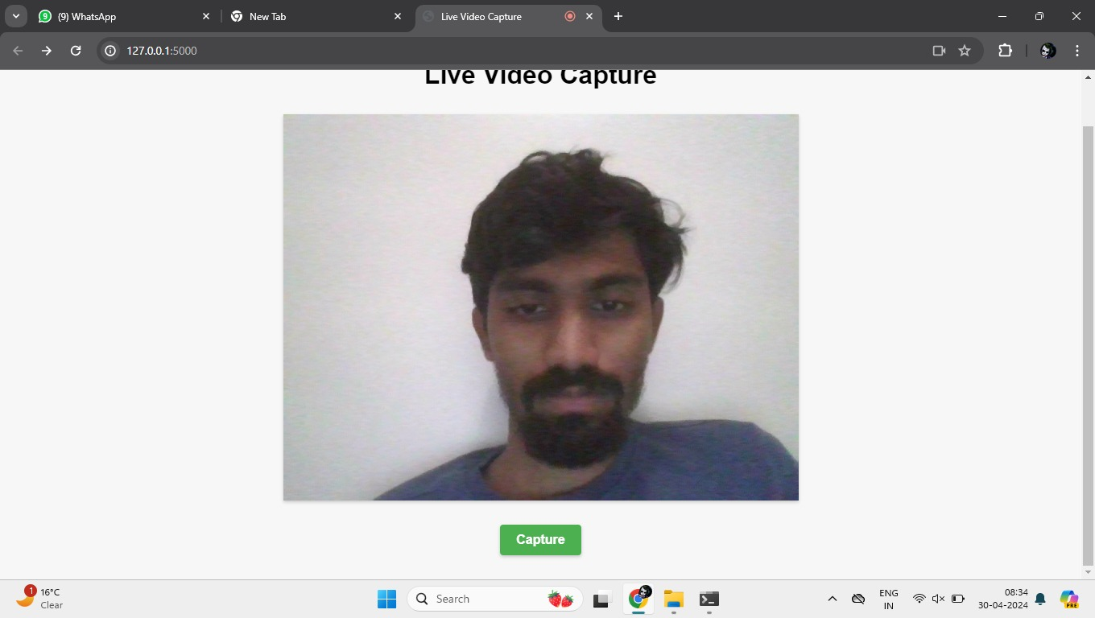
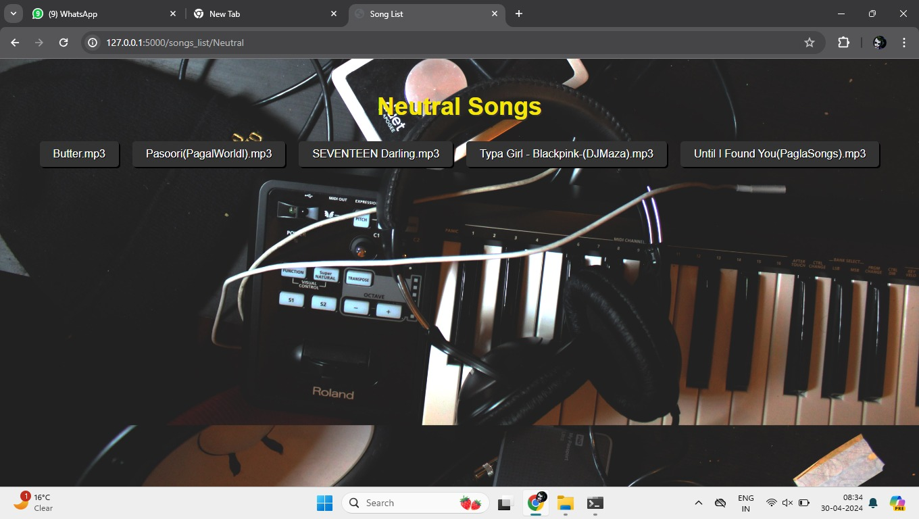

Slide 21

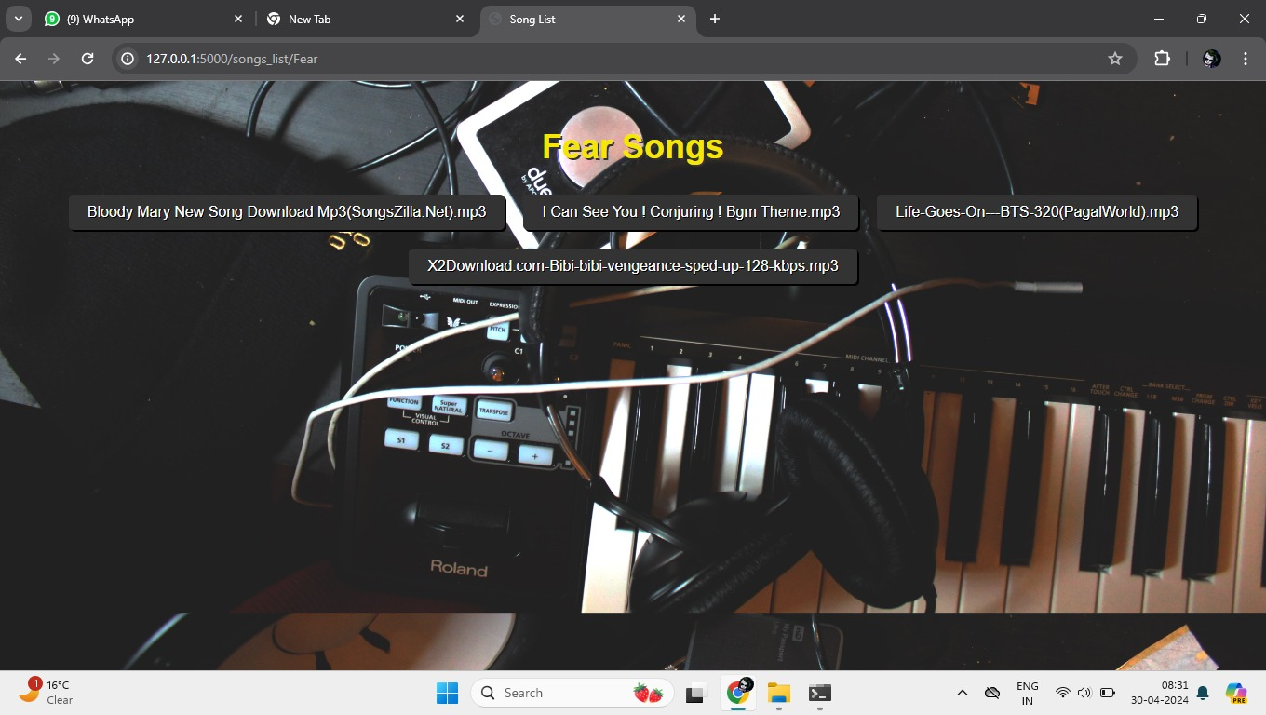

Slide 22



Slide 23
CONCLUSION:
Even though human emotions are complex and subtle, it is possible for a machine learning model to be trained to accurately detect a set of emotions which can be differentiated from each other with certain facial expressions.
The expression on a person’s face can be used to detect their mood, and once a certain mood has been detected, music suitable for the person’s detected mood can be suggested.
Our model, having the accuracy of approximately 83%, is able to detect five moods accurately: anger, happy, sad, surprise and calm; and our android application is able to play the music that would be suitable for the detected mood.

Slide 24


